Slide 1
11
Chapter
Leadership
and
Trust
Copyright ©2011 Pearson Education

Slide 2
Who Are Leaders, and What Is Leadership?
Leader
  Someone who can influence others and who has managerial authority
Leadership
  The process of leading a group and influencing that group to achieve its goals
People work for managers; they follow leaders.

Slide 3
What Traits Do Leaders Have?
Trait Theories of Leadership
  These theories were based on early leadership research
  Theories that isolate personality, social, physical, or intellectual characteristics (traits) that differentiate leaders from non-leaders

Slide 4
Trait Theories of Leadership
If the concept of traits were valid, all leaders would have to possess specific characteristics.
Not very useful, until matched with the Big Five Personality Framework
  Extraversion
  Conscientiousness
  Openness
  Emotional Intelligence
Traits can predict leadership, but they are better at predicting leader emergence than effectiveness.

Slide 5
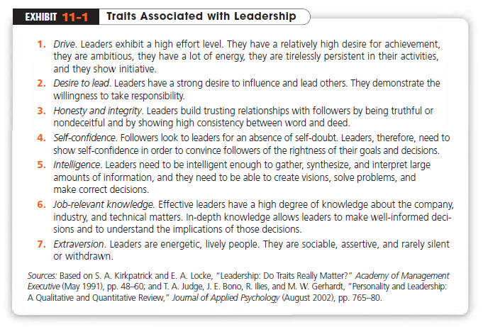
Copyright ©2011 Pearson Education

Slide 6
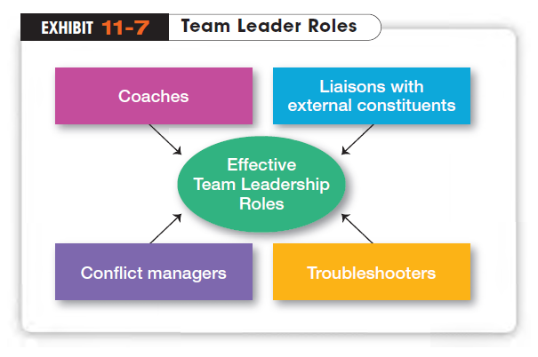
A meaningful way to describe the team leader’s job is to focus on two priorities: (1) managing the team’s external boundary,
and(2) facilitating the team process.
These priorities entail four specific leadership roles
Copyright ©2011 Pearson Education

Slide 7
What Behaviors Do Leaders Exhibit?
A number of studies looked at behavioral styles.
Behavioral Theories of Leadership
  Theories that isolate behaviors that differentiate effective leaders from ineffective leaders

Slide 8
Leadership Behaviors
One of the first studies of leadership behavior was done by Kurt Lewin and his associates at the University of Iowa. Researchers explored three leadership behaviors or styles:
Autocratic Style
  A leader who centralizes authority, dictates work methods, makes unilateral decisions, and limits employee participation
Copyright ©2011 Pearson Education

Slide 9
Leadership Behaviors (cont.)
Participative Style
  A leader who involves employees in decision making, delegates authority, encourages participation in deciding work methods, and uses feedback to coach employees
Laissez-Faire Style
  A leader who generally gives employees complete freedom to make decisions and to complete their work however they see fit
  might simply provide necessary materials and answer questions
Copyright ©2011 Pearson Education

Slide 10
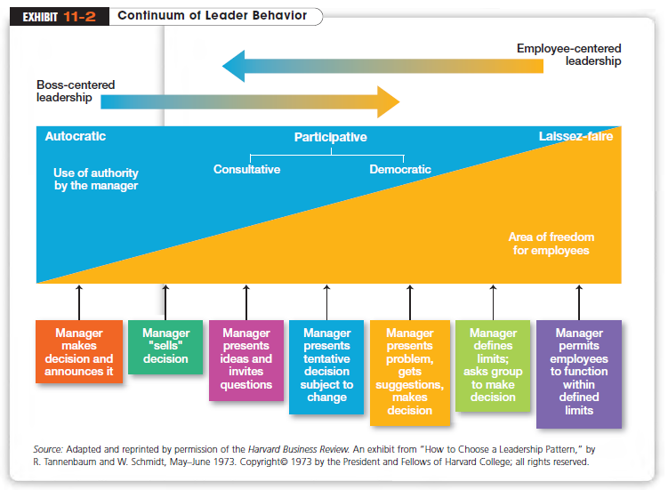
Copyright ©2011 Pearson Education

Slide 11
Leadership Behavior Studies
The most comprehensive and replicated of the behavioral theories resulted from research that began at Ohio State University.
The researchers eventually narrowed the list down to two categories that accounted for most of the leadership behavior described by employees.

Slide 12
Ohio State Studies
Identified two categories that accounted for most of the leadership behavior in the late 1940s.
Initiating Structure
  The extent to which a leader defines and structures his or her role and the roles of employees to attain goals
Consideration
  The extent to which a leader has job relationships characterized by mutual trust, respect for employees’ ideas, and regard for their feelings
Copyright ©2011 Pearson Education

Slide 13
How Did the University of Michigan Studies Differ?
Leadership studies undertaken at about the same time as those being done at Ohio State, had similar research objectives: to locate the behavioral characteristics that were related to performance effectiveness. Also developed two dimensions of leadership behavior
Employee Oriented
  A leader who emphasizes the people aspects.
Production Oriented
  A leader who emphasizes the technical or task aspects
Copyright ©2011 Pearson Education

Slide 14
Managerial Grid
  A two-dimensional grid for appraising leadership styles based on
Identified five styles for management
  impoverished management
  task management
  middle-of-the-road management
  country club
  team management
Copyright ©2011 Pearson Education
Notes:
The managerial grid used the behavioral dimensions “concern for people” and “concern for production” and evaluated a leader’s use of these behaviors, ranking them on a scale from 1 (low) to 9 (high).

Slide 15
Contingency Approaches in Management
The key to contingency approaches is that situations, and not managers determine the approach that managers should use, making situations the correct response.
Since situations vary in different organizations, different approaches needs to be employed.

Slide 16
The First Contingency Model
Fiedler Contingency Model of Leadership
  proposes that effective group performance depends on the proper match between a leader’s style and the degree to which the situation allowed the leader to control and influence
  To measure a leader’s style, Fiedler developed the Least-Preferred Co-Worker (LPC) Questionnaire measures whether a leader was task (low LPC) or relationship oriented (high LPC)
Copyright ©2011 Pearson Education

Slide 17
Three Contingency Dimensions
Fiedler’s research uncovered contingency dimensions that defined the key situational factors in leader effectiveness
Leader-member relations
  the degree of confidence, trust, and respect employees had for their leader
Position power
  a leader’s degree of influence over activities such as hiring, firing, discipline, promotions, and salary increases
Task structure
  the degree to which job assignments were formalized and structured
Copyright ©2011 Pearson Education

Slide 18
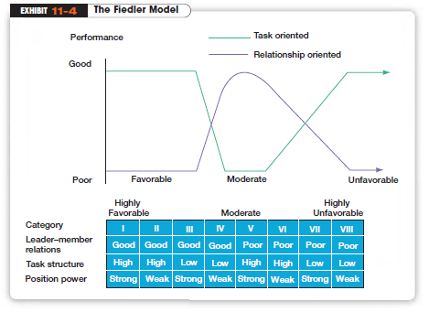
Task oriented perform best in high and low control, relationship oriented in moderate control.
Because Fiedler treated an individual’s leadership style as fixed, there were only two ways to improve leader effectiveness:
First, you could bring in a new leader whose style better fit the situation.
The second alternative was to change the situation to fit the leader.
Copyright ©2011 Pearson Education

Slide 19
How Do Followers’ Willingness and Ability Influence Leaders?
Situational Leadership Theory (SLT)
  A leadership contingency theory that focuses on followers’ readiness
Readiness
  The extent to which people have the ability and willingness to accomplish a specific task
Copyright ©2011 Pearson Education

Slide 20
Four Situational Styles
SLT uses the same two leadership dimensions that Fiedler identified: task and relationship behaviors. However, Hersey and Blanchard go a step further by considering each as either high or low and then combining them into four specific leadership styles
Telling (high task–low relationship)
  The leader defines roles and tells people what, how, when, and where to do various tasks
Selling (high task–high relationship)
  provides both directive and supportive behavior
Copyright ©2011 Pearson Education

Slide 21
Four Styles (cont.)
Participating (low task–high relationship)
  The leader and followers share in decision making; the main role is facilitating and communicating
Delegating (low task–low relationship)
  The leader provides little direction or support
  SLT essentially views the leader-follower relationship as like that of a parent and a child. Just as a parent needs to relinquish control when a child becomes more mature, so too, should leaders

Slide 22
Example
An interdepartmental task force that you manage in your hotel, has been assigned a new task force member. He must complete some cost figures for his department by next week but knows nothing about the task force's requirements or the format of the report.
He is excited and enthused about learning more concerning his role on the task force.
What is the appropriate Leadership Style for this situation?
“Tell him exactly what to do and closely monitor his progress”

Slide 23
Situational Leadership Theory
A leader should choose one of four behaviors depending on follower readiness.
Ability to Follow | Willingness to Follow | Leadership Behavior
Unable | Willing | Give clear and specific directions
Unable | Unwilling | Display high task orientation
Able | Unwilling | Use a supportive and participatory style
Able | Willing | Doesn’t need to do much
Notes:
(c) 2008 Prentice-Hall, All rights reserved.

Slide 24
How Participative Should a Leader Be?
Leader-Participation Model
  A contingency theory that’s based on a sequential set of rules for determining how much participation a leader uses in decision making according to different types of situations
  Leader behaviors must adjust to reflect task structure
  “Normative” model: tells leaders how participative to be in their decision-making of a decision tree
    5 leadership styles: Authoritarian I & II, Communicator I & II, Team
    Twelve contingency variables
Copyright ©2011 Pearson Education
Notes:
Back in 1973, Victor Vroom and Phillip Yetton developed a leader-participation model that related leadership behavior and participation to decision making.

Slide 25
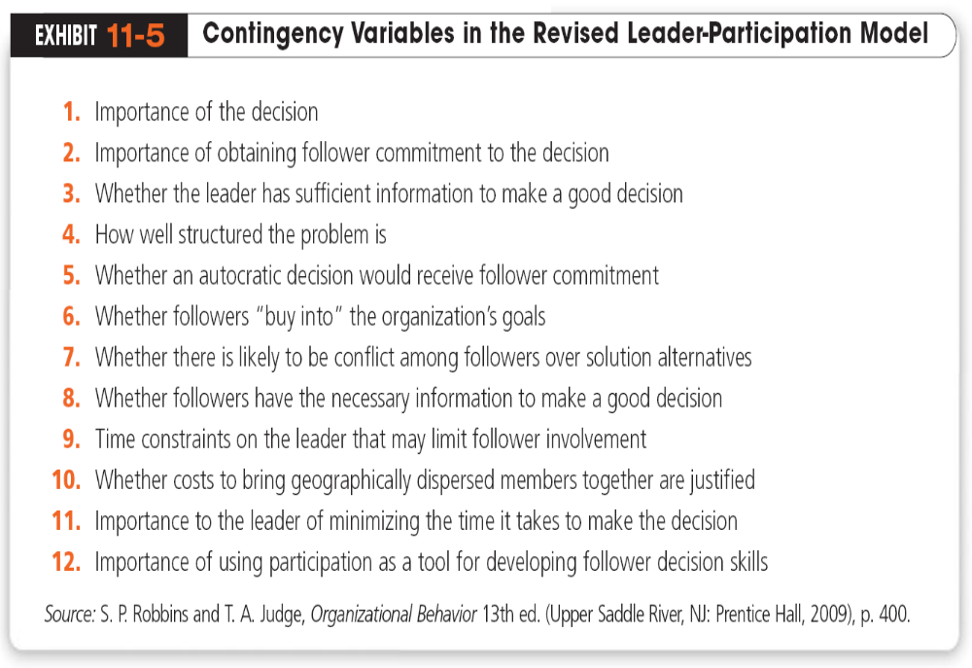
Copyright ©2011 Pearson Education

Slide 26
Vroom and Yetton’s Leader-Participation Model
How a leader makes decisions is as important as what is decided.
Research testing for both original and modified models has not been encouraging
  Model is overly complex for the typical manager to use on a regular basis → A computer program

Slide 27
Why Do Leaders Need to Empower Employees?
Empowerment is the act of increasing the decision-making discretion of workers
Those at the lower levels of the organization often have the knowledge to make quick decisions
Copyright ©2011 Pearson Education

Slide 28
How Do Leaders Help Followers?
Path-Goal Theory
  Currently, one of the most respected approaches to understanding leadership
  the theory that says the leader’s job is to assist followers in attaining their goals
  and to provide direction or support needed to ensure that their goals are compatible with the organization’s or group’s goals
In particular, leaders:
Clarify the path so subordinates know which way to go
Remove roadblocks that are stopping them going there
Increasing the rewards along the route
Copyright ©2011 Pearson Education

Slide 29
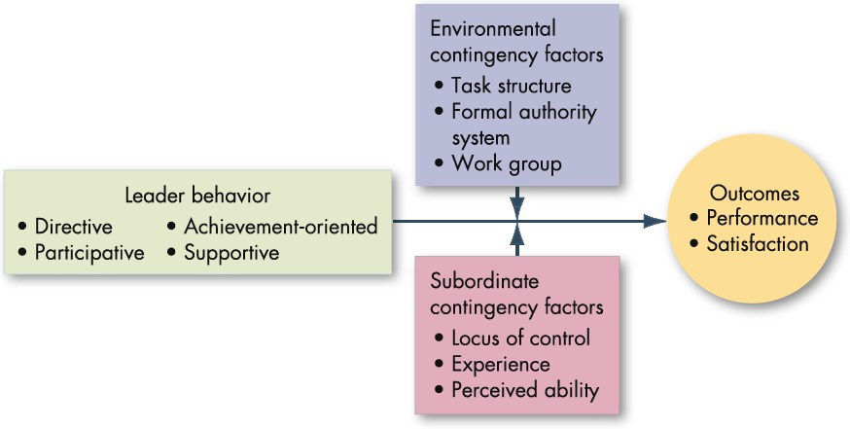
Path-Goal Model: 4 types of leaders; 2 sets of contingencies

Slide 30
Bias of the Theories
Because most leadership theories were developed in the US, they have a cultural bias.
They emphasize follower responsibilities rather than rights; assume self-gratification rather than commitment to duty or altruistic motivation; assume centrality of work and democratic value orientation; and stress rationality rather than spirituality, religion, or superstition.

Slide 31
Paternalistic Leadership Theory seems to work better in China and Turkey (both relatively collectivistic and high power distance).
Good natured paternalistic leader is the “father-figure” of in the firm; interested in the well-being and problems of the employee personally (attends wedding and funerals, etc.)
In cases, the leader is aware of status differences, autocratic, demanding, fair in conflict handling but harmony orientated.

Slide 32
What Do Contemporary Views of Leadership Tell Us?
Many early leadership theories viewed leaders as Transactional Leaders
  Leaders who lead primarily by exchanging rewards for their productivity and motivate followers to work toward established goals
Transformational Leaders
  Leaders who stimulate and inspire (transform) followers to achieve extraordinary outcomes
  Provides vision and sense of mission, instills pride, gains respect and trust, communicates high expectations; Intellectual Stimulation, Individualized Consideration
Copyright ©2011 Pearson Education

Slide 33
How Do Charismatic and Visionary Leaders Differ?
Charismatic Leaders
  Enthusiastic, self-confident leaders whose personalities and actions influence people to behave in certain ways
Visionary Leadership
  The ability to create and articulate a realistic, credible, and attractive vision of the future that improves on the present situation
Copyright ©2011 Pearson Education

Slide 34
Trust is the Essence of Leadership
Credibility
  The degree to which followers perceive someone as honest, competent, and able to inspire
Trust
  The belief in the integrity, character, and ability of a leader

Slide 35
5 Key Dimensions of Trust
Integrity
  honesty and truthfulness
Competence
  individual’s technical and interpersonal knowledge and skills
Consistency
  individual’s reliability, predictability, and good judgment in handling situations
Loyalty
  willingness to protect a person physically as well as emotionally, and save face for another person
Openness
  Willingness to share ideas and information freely

Slide 36
Reserach showed that trust is the ‘Secret Ingredient’ for effective leadership.
Trust, or lack of trust, is an increasingly important issue in today’s uncertain environment; thus leaders need to build, or even rebuild, trust and credibility.
Trust in supervisor begets organizational commitment, and job satisfaction; outcome is better performance.

